Slide 1
Chapter 9
How to work with session state and cookies

Slide 2
Objectives (part 1)
Applied
Use session state to store user data that should persist across multiple requests in a session.
Use cookies to store user data that should persist across multiple sessions.
Knowledge
List the six ways that you can handle state with ASP.NET Core MVC.
Describe how session state works with the focus on the session ID.
Describe how to enable session state for an ASP.NET Core MVC web app, including how to change its default settings.
Describe the use of session state in controllers and views.

Slide 3
Objectives (part 2)
Describe how to use JSON to store .NET objects in session state.
Describe how adding extension methods to the ISession interface can make it easier to store objects in session state.
Describe how a wrapper class can make it easier to work with session state.
Distinguish between a session cookie and a persistent cookie.
Describe the use of cookies, including how to set a persistent cookie.

Slide 4
Common web programming features for maintaining state
Hidden field
Query string
Cookie
Session state
Two ASP.NET Core MVC features for maintaining state
Routes
TempData

Slide 5
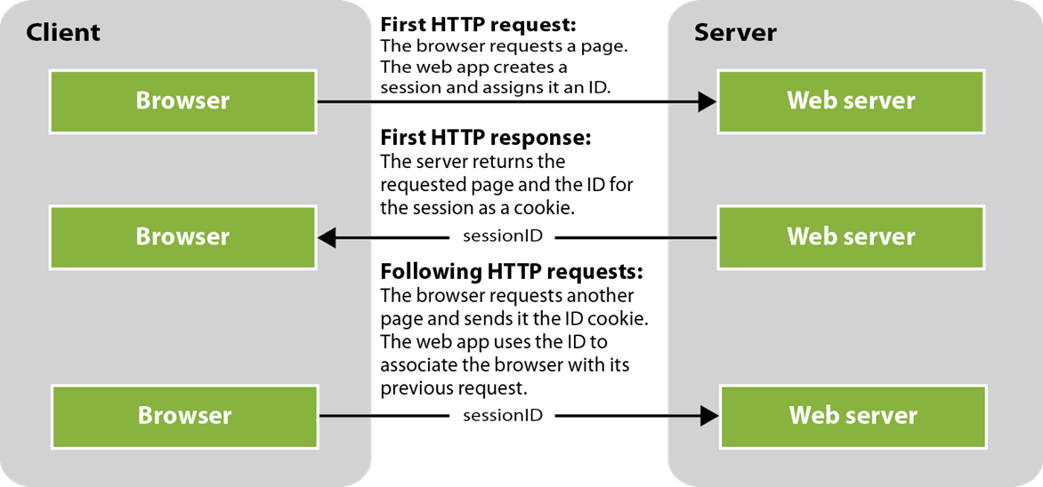
How ASP.NET Core MVC keeps track of a session

Slide 6
How to configure an app to use session state (part 1)
The ConfigureServices() method in the Startup.cs file
public void ConfigureServices(IServiceCollection services)
{
...
// must be called before AddControllersWithViews()
services.AddMemoryCache();
services.AddSession();
services.AddControllersWithViews();
...
}

Slide 7
How to configure an app to use session state (part 2)
The Configure() method in the Startup.cs file
public void Configure(IAppBuilder app, IHostingEnvironment env)
{
...
// must be called before UseEndpoints()
app.UseSession();
app.UseEndpoints(endpoints =>
{
endpoints.MapControllerRoute(
name: "default",
pattern: "{controller=Home}/{action=Index}/{id?}");
});
...
}

Slide 8
How to change the default session state settings
services.AddSession(options =>
{
// change idle timeout to 5 minutes - default is 20 minutes
options.IdleTimeout = TimeSpan.FromSeconds(60 * 5);
options.Cookie.HttpOnly = false; // default is true
options.Cookie.IsEssential = true; // default is false
});

Slide 9
Methods of the ISession interface that set, get, and remove items
SetInt32(key, value)
SetString(key, value)
GetInt32(key)
GetString(key)
Remove(key)

Slide 10
A using directive for session state in a controller
using Microsoft.AspNetCore.Http;
An action method that gets and sets a session state value
public ViewResult Index() {
int num = HttpContext.Session.GetInt32("num");
num += 1;
HttpContext.Session.SetInt32("num", num);
return View();
}

Slide 11
A using directive for session state in a view
@using Microsoft.AspNetCore.Http
A Razor code block that gets a session state value
@{
int num = Context.Session.GetInt32("num");
}
A Razor expression that gets a session state value
<div>@Context.Session.GetInt32("num")</div>

Slide 12
How to add the Newtonsoft JSON NuGet package
Use the Tools→NuGet Package Manager→Manage NuGet Packages for Solution command to open the NuGet Package Manager.
Click the Browse link.
Type “Microsoft.AspNetCore.Mvc.NewtonsoftJson” in the search box.
Click on the appropriate package from the list that appears in the left-hand panel.
In the right-hand panel, check the project name, select the version that matches the version of .NET Core you’re running, and click Install.
Review the Preview Changes dialog that comes up and click OK.
Review the License Acceptance dialog that comes up and click I Accept.

Slide 13
How to configure your app to use the Newtonsoft JSON library
public void ConfigureServices(IServiceCollection services) {
...
services.AddMemoryCache();
services.AddSession();
services.AddControllersWithViews().AddNewtonsoftJson();
...
}

Slide 14
How to import the Newtonsoft JSON library
using Newtonsoft.Json;
Two static methods of the JsonConvert class
SerializeObject(object)
DeserializeObject<T>(string)
Code that sets a Team object in session state
Team team =
new Team { TeamID = "sea", Name = "Seattle Seahawks" };
string teamJson = JsonConvert.SerializeObject(team);
HttpContext.Session.SetString("team", teamJSON);
Code that gets a Team object from session state
string teamJson = HttpContext.Session.GetString("team");
Team team =
JsonConvert.DeserializeObject<Team>(teamJson);

Slide 15
Two extension methods for the ISession interface
using Microsoft.AspNetCore.Http;
using Newtonsoft.Json;
...
public static class SessionExtensions
{
public static void SetObject<T>(this ISession session,
string key, T value) {
session.SetString(key,
JsonConvert.SerializeObject(value));
}
public static T GetObject<T>(this ISession session,
string key) {
var valueJson = session.GetString(key);
if (string.IsNullOrEmpty(value)) {
return default(T);
}
else {
return JsonConvert.DeserializeObject<T>(valueJson);
}
}
}

Slide 16
Code that uses the extension methods to work with a single team
In a controller
var team =
HttpContext.Session.GetObject<Team>("team") ?? new Team();
team.Name = "Seattle Seahawks";
HttpContext.Session.SetObject("team", team);
In a view
@{
var team = Context.Session.GetObject<Team>("team");
}

Slide 17
Code that uses the extension methods to work with a list of teams
In a controller
var teams = HttpContext.Session.GetObject<List<Team>>("teams") ??
new List<Team>();
teams.Add(new Team { TeamID = "gb",
Name = "Green Bay Packers" });
HttpContext.Session.SetObject("teams", teams);
In a view
@{
var teams = Context.Session.GetObject<List<Team>>("teams");
}

Slide 18
A wrapper class that encapsulates the code for working with session state
using Microsoft.AspNetCore.Http;
...
public class MySession
{
private const string TeamsKey = "teams";
private ISession session { get; set; }
public MySession(ISession sess) {
session = sess;
}
public List<Team> GetTeams() =>
session.GetObject<List<Team>>(TeamsKey) ??
new List<Team>();
public void SetTeams(List<Team> teams) =>
session.SetObject(TeamsKey, teams);
}

Slide 19
Code that uses the wrapper class to work with a list of teams
In a controller
var session = new MySession(HttpContext.Session);
var teams = session.GetTeams();
teams.Add(new Team { TeamID = "gb",
Name = "Green Bay Packers" });
session.SetTeams(teams);
In a view
@{
var session = new MySession(Context.Session);
var teams = session.GetTeams();
}

Slide 20
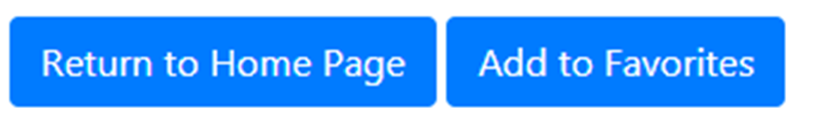
Two buttons on the Details page (NFL Teams 3.0)

Slide 21
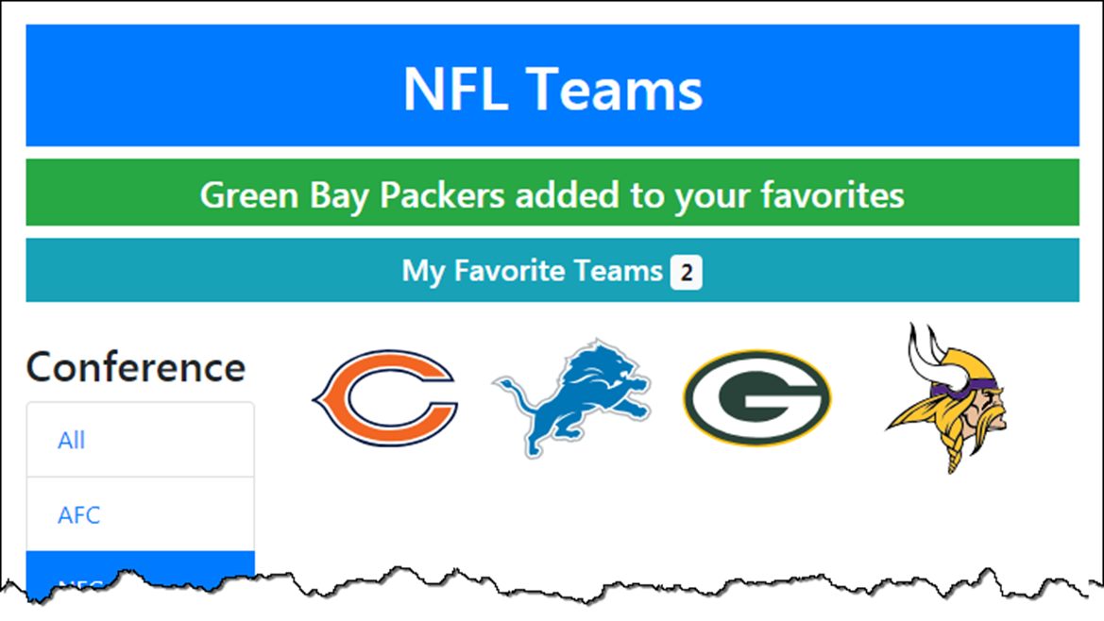
The Home page after a team has been added to favorites (NFL Teams 3.0)

Slide 22
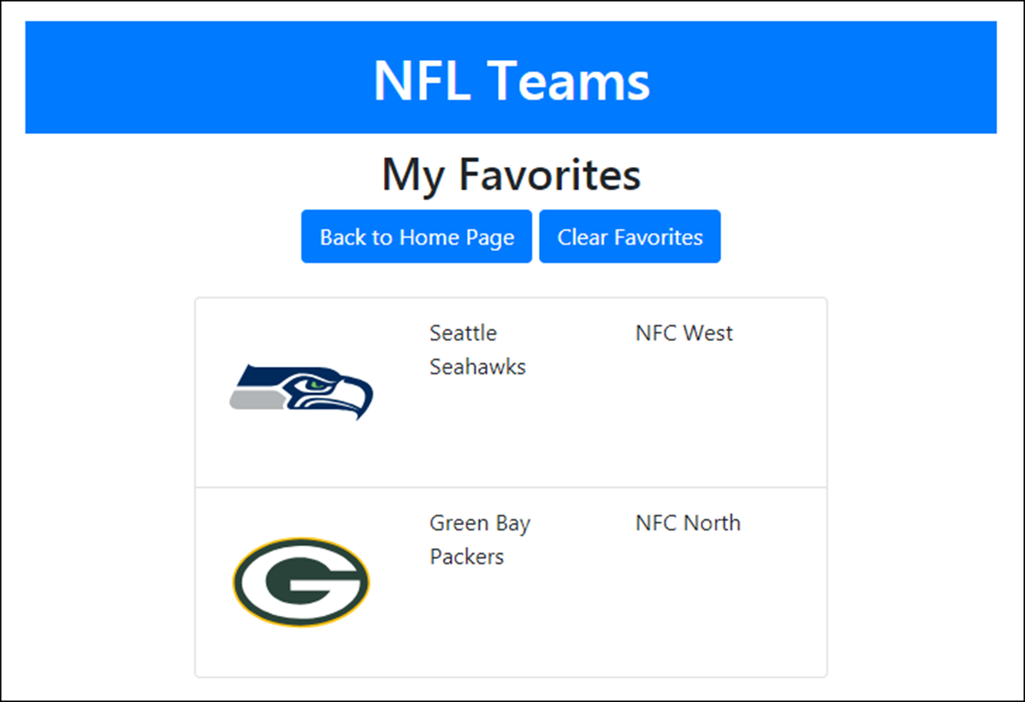
The Favorites page (NFL Teams 3.0)

Slide 23
The SessionExtensions class
using Microsoft.AspNetCore.Http;
using Newtonsoft.Json;
...
public static class SessionExtensions
{
public static void SetObject<T>(this ISession session,
string key, T value)
{
session.SetString(key, JsonConvert.SerializeObject(value));
}
public static T GetObject<T>(this ISession session, string key)
{
var value = session.GetString(key);
return (value == null) ? default(T) :
JsonConvert.DeserializeObject<T>(value);
}
}

Slide 24
The NFLSession class (part 1)
using Microsoft.AspNetCore.Http;
...
public class NFLSession
{
private const string TeamsKey = "myteams";
private const string CountKey = "teamcount";
private const string ConfKey = "conf";
private const string DivKey = "div";
private ISession session { get; set; }
public NFLSession(ISession session) {
this.session = session;
}
public void SetMyTeams(List<Team> teams) {
session.SetObject(TeamsKey, teams);
session.SetInt32(CountKey, teams.Count);
}
public List<Team> GetMyTeams() =>
session.GetObject<List<Team>>(TeamsKey) ?? new List<Team>();
public int GetMyTeamCount() => session.GetInt32(CountKey) ?? 0;

Slide 25
The NFLSession class (part 2)
public void SetActiveConf(string activeConf) =>
session.SetString(ConfKey, activeConf);
public string GetActiveConf() => session.GetString(ConfKey);
public void SetActiveDiv(string activeDiv) =>
session.SetString(DivKey, activeDiv);
public string GetActiveDiv() => session.GetString(DivKey);
public void RemoveMyTeams() {
session.Remove(TeamsKey);
session.Remove(CountKey);
}
}

Slide 26
The updated Index() action method of the Home controller
public ViewResult Index(string activeConf = "all",
string activeDiv = "all")
{
var session = new NFLSession(HttpContext.Session);
session.SetActiveConf(activeConf);
session.SetActiveDiv(activeDiv);
// rest of code same as figure 8-11
}

Slide 27
The updated Details() action method of the Home controller
public ViewResult Details(string id)
{
var session = new NFLSession(HttpContext.Session);
var model = new TeamViewModel
{
Team = context.Teams
.Include(t => t.Conference)
.Include(t => t.Division)
.FirstOrDefault(t => t.TeamID == id),
ActiveDiv = session.GetActiveDiv(),
ActiveConf = session.GetActiveConf()
};
return View(model);
}

Slide 28
The Add() action method of the Home controller (NFL Teams 3.0)
[HttpPost]
public RedirectToActionResult Add(TeamViewModel model) {
model.Team = context.Teams
.Include(t => t.Conference)
.Include(t => t.Division)
.Where(t => t.TeamID == model.Team.TeamID)
.FirstOrDefault();
var session = new NFLSession(HttpContext.Session);
var teams = session.GetMyTeams();
teams.Add(model.Team);
session.SetMyTeams(teams);
TempData["message"] =
$"{model.Team.Name} added to your favorites";
return RedirectToAction("Index",
new {
ActiveConf = session.GetActiveConf(),
ActiveDiv = session.GetActiveDiv()
});
}

Slide 29
The layout (part 1)
<!DOCTYPE html>
<html>
<head>
<meta name="viewport" content="width=device-width" />
<link href="~/lib/bootstrap/dist/css/bootstrap.min.css"
rel="stylesheet" />
<link href="~/css/site.css" rel="stylesheet" />
<title>@ViewBag.Title</title>
</head>
<body>
<div class="container">
<header class="text-center text-white">
<h1 class="bg-primary mt-3 p-3">NFL Teams</h1>
@* show any message in TempData *@
@if (TempData["message"] != null)
{
<h4 class="bg-success p-2">@TempData["message"]</h4>
}

Slide 30
The layout (part 2)
@* show link to Favorites page unless on page *@
@if (!ViewContext.View.Path.Contains("Favorites"))
{
var session = new NFLSession(Context.Session);
<h5 class="bg-info p-2">
<a asp-controller="Favorites"
class="text-white">My Favorite Teams</a>
@* display number of fav teams in badge *@
<span class="badge badge-light">
@(session.GetMyTeamCount())</span>
</h5>
}
</header>
<main>
@RenderBody()
</main>
</div>
</body>
</html>

Slide 31
Some code from the Home/Index view
<div class="col-sm-9">
<ul class="list-inline">
@foreach (Team team in Model.Teams)
{
<li class="list-inline-item">
<a asp-action="Details" asp-route-id="@team.TeamID">
<img src="~/images/@team.LogoImage"
alt="@team.Name"
title="@team.Name | @team.Conference.Name
@team.Division.Name" />
</a>
</li>
}
</ul>
</div>

Slide 32
Some code from the Home/Details view
<li class="list-group-item">
<form asp-action="Add" method="post">
<a asp-action="Index" class="btn btn-primary"
asp-route-activeConf="@Model.ActiveConf"
asp-route-activeDiv="@Model.ActiveDiv">
Return to Home Page</a>
<button type="submit" class="btn btn-primary">
Add to Favorites
</button>
<input type="hidden" asp-for="Team.TeamID" />
</form>
</li>

Slide 33
The Favorites controller (part 1)
public class FavoritesController : Controller
{
[HttpGet]
public ViewResult Index()
{
var session = new NFLSession(HttpContext.Session);
var model = new TeamListViewModel
{
ActiveConf = session.GetActiveConf(),
ActiveDiv = session.GetActiveDiv(),
Teams = session.GetMyTeams()
};
return View(model);
}

Slide 34
The Favorites controller (part 2)
[HttpPost]
public RedirectToActionResult Delete()
{
var session = new NFLSession(HttpContext.Session);
session.RemoveMyTeams();
TempData["message"] = "Favorite teams cleared";
return RedirectToAction("Index", "Home",
new {
ActiveConf = session.GetActiveConf(),
ActiveDiv = session.GetActiveDiv()
});
}
}

Slide 35
The Favorites/Index view (part 1)
@model TeamListViewModel
@{
ViewData["Title"] = "Favorites";
}
<div class="text-center">
<h2>My Favorites</h2>
<form asp-action="Delete" method="post">
<a asp-action="Index" asp-controller="Home"
class="btn btn-primary"
asp-route-activeConf="@Model.ActiveConf"
asp-route-activeDiv="@Model.ActiveDiv">
Back to Home Page</a>
<button type="submit" class="btn btn-primary">
Clear Favorites
</button>
</form>
<br />
</div>

Slide 36
The Favorites/Index view (part 2)
<div class="row">
<div class="col-8 offset-2">
<ul class="list-group">
@foreach (Team team in Model.Teams)
{
<li class="list-group-item">
<div class="row">
<div class="col-sm-4">
<img src=~/images/@team.LogoImage"
alt="" />
</div>
<div class="col-sm-4">
@team.Name
</div>
<div class="col-sm-4">
@team.Conference.Name
@team.Division.Name
</div>
</div>
</li>
}
</ul>
</div>
</div>

Slide 37
Two properties of the Controller class
Request
Response
Code that sets a session cookie
Response.Cookies.Append("username", "Grace");
Code that deletes a cookie
Response.Cookies.Delete("username");
Code that gets a cookie
string value = Request.Cookies["username"];

Slide 38
Properties of the CookieOptions class
Domain
Expires
Path
MaxAge
SameSite
Secure
A using directive for working with the CookieOptions class
using Microsoft.AspNetCore.Http;
Code that sets a persistent cookie
var options = new CookieOptions {
Expires = DateTime.Now.AddDays(30)
};
Response.Cookies.Append("username", "Grace", options);

Slide 39
The NFLCookies class (part 1)
using Microsoft.AspNetCore.Http;
...
public class NFLCookies
{
private const string MyTeams = "myteams";
private const string Delimiter = "-";
private IRequestCookieCollection requestCookies { get; set; }
private IResponseCookies responseCookies { get; set; }
public NFLCookies(IRequestCookieCollection cookies) {
requestCookies = cookies;
}
public NFLCookies(IResponseCookies cookies) {
responseCookies = cookies;
}

Slide 40
The NFLCookies class (part 2)
public void SetMyTeamIds(List<Team> myteams){
List<string> ids = myteams.Select(t => t.TeamID).ToList();
string idsString = String.Join(Delimiter, ids);
CookieOptions options = new CookieOptions {
Expires = DateTime.Now.AddDays(30)
};
RemoveMyTeamIds(); // delete old cookie first
responseCookies.Append(MyTeams, idsString, options);
}
public string[] GetMyTeamsIds() {
string cookie = requestCookies[MyTeams];
if (string.IsNullOrEmpty(cookie))
return new string[] { }; // empty string array
else
return cookie.Split(Delimiter);
}
public void RemoveMyTeamIds(){
responseCookies.Delete(MyTeams);
}
}

Slide 41
The updated NFLSession class
public class NFLSession
{
...
public int? GetMyTeamCount() =>
session.GetInt32(CountKey);
...
}

Slide 42
The Index() action method of the Home controller
public ViewResult Index(string activeConf = "all",
string activeDiv = "all")
{
var session = new NFLSession(HttpContext.Session);
session.SetActiveConf(activeConf);
session.SetActiveDiv(activeDiv);
// if no count in session, get cookie and restore fave teams
int? count = session.GetMyTeamCount();
if (count == null) {
var cookies = new NFLCookies(Request.Cookies);
string[] ids = cookies.GetMyTeamIds();
List<Team> myteams = new List<Team>();
if (ids.Length > 0) {
myteams = context.Teams.Include(t => t.Conference)
.Include(t => t.Division)
.Where(t => ids.Contains(t.TeamID)).ToList();
}
session.SetMyTeams(myteams);
}
// rest of code same as figure 8-11
}

Slide 43
The Add() action method of the Home controller (NFL Teams 4.0)
[HttpPost]
public RedirectToActionResult Add(TeamViewModel model) {
model.Team = context.Teams
.Include(t => t.Conference).Include(t => t.Division)
.Where(t => t.TeamID == model.Team.TeamID)
.FirstOrDefault();
var session = new NFLSession(HttpContext.Session);
var teams = session.GetMyTeams();
teams.Add(model.Team);
session.SetMyTeams(teams);
var cookies = new NFLCookies(Response.Cookies);
cookies.SetMyTeamIds(teams);
TempData["message"] =
$"{model.Team.Name} added to your favorites";
return RedirectToAction("Index",
new { ActiveConf = session.GetActiveConf(),
ActiveDiv = session.GetActiveDiv() });
}

Slide 44
The Delete() action method of the Favorites controller
[HttpPost]
public RedirectToActionResult Delete()
{
var session = new NFLSession(HttpContext.Session);
var cookies = new NFLCookies(Response.Cookies);
session.RemoveMyTeams();
cookies.RemoveMyTeamIds();
TempData["message"] = "Favorite teams cleared";
return RedirectToAction("Index", "Home",
new {
ActiveConf = session.GetActiveConf(),
ActiveDiv = session.GetActiveDiv()
}
);
}

